Slide 1


Identifying Key Factors to Predict Prevalence of Heart Diseases in the United States
by
Chris Cooks, Kolapo Aluko, Babatunde Atolagbe
Team 01
Data Science For All / Empowerment 3
(March, 2022)

Slide 2
Background
Heart Disease is a variety of conditions that affect the heart’s structure and function.
Until 2020, prior to COVID 19, heart disease was the leading cause of death in the United States; as well as a major cause of disability.
Per Centers for Disease Control and Prevention (CDC), about 659k deaths are caused by heart disease annually.
Types of Heart Diseases:
Coronary Heart
Heart Arrhythmias
Heart Failure
Cardiomyopathy (Heart Muscle)
Many risk factors, socio-economic factors, and healthcare access impact the cause and prevention of heart disease.
What key factors can be used to help predict the prevalence of heart disease by county in the United States?

Slide 3
Dataset
Source: CDC interactive website
CDC Interactive Data on Heart Disease
Risk Factors
1. High Cholesterol Awareness
2. Diagnosed Diabetes
3. Obesity
4. Smoking
5. Leisure Time Physical Inactivity
Healthcare Opportunities
1. Cardiac Rehabilitation Eligibility
2. Cholesterol Medication
3. Cholesterol Screening
4. Cardiac Rehabilitation Sessions
6. Cardiac Rehabilitation Participation
7. Cardiac Rehabilitation.
Units
Socio-Economic Factors
1. Air quality
2. Park access
3. Population of aged 65 and above
4. Total population
5. Urban-rural classification
6. Median household income
7. Poverty rate
Heart Disease
Data
1. Prevalence
*Coronary Heart Disease
Healthcare costs
1. Total cost per
capita amongst
medicaid
beneficiaries
Note: Only variables of interest are shown here.
Dashboard Here
Notes:
For our dataset, we exported 38 factors from the CDC website and categorized the factors into the following buckets, with the focus on Prevalence on Coronary Heart Disease specifically.
The buckets are
Risk Factors: Health and wellness factors that can contribute to the increased likelihood of obtaining heart diesease
- Healthcare Opportunities: Access to different healthcare measures that can provide opportunities for prevention and/or cure of heart diseases
- Socio-Economic Factors: Links between the quality of life and prevalence of heart disease
- Healthcare Costs: Total cost per capital amongst healthcare beneficiaries
- As our group proceeded with the data cleaning, data exploration and modeling, we kept these groups of factors in mind and hoped to find ways to see how they interacted with each other .
Pass to Kolapo for the dashboard.

Slide 4
Data Wrangling
Merged the raw “.csv” files for all factors into one big dataset with shape 3226 x 40.
Dealing with missing data:
Removing all “NaNs” at once yielded 519 x 40.
Too much is data lost.
Thus, strategic removal and/or imputation process is required.
Systematic removal / imputation process:
Completely dropped four variables with up to 60% missing rows.
Necessary to avoid introducing bias in the datasets via unwarranted imputation.
Mean imputation was used for “air_quality” and “cholesterol_medication” (both with less than 3% missing data).
Dropped the remaining missing rows in the data.
Resulting dataset (2310 x 36):
2310 counties
36 variables

Slide 5
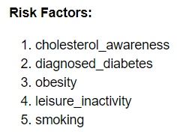
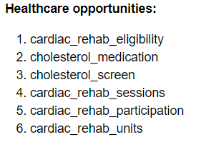
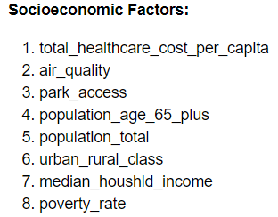
Data Exploration
Identification of variables of interest.
Use of correlation coefficients.
Statistical significance test of the coefficients (p-value < 0.05)
Use of heat maps
Visualization of distributions of the variables.
Use of Histograms
Selected variables:

Slide 6
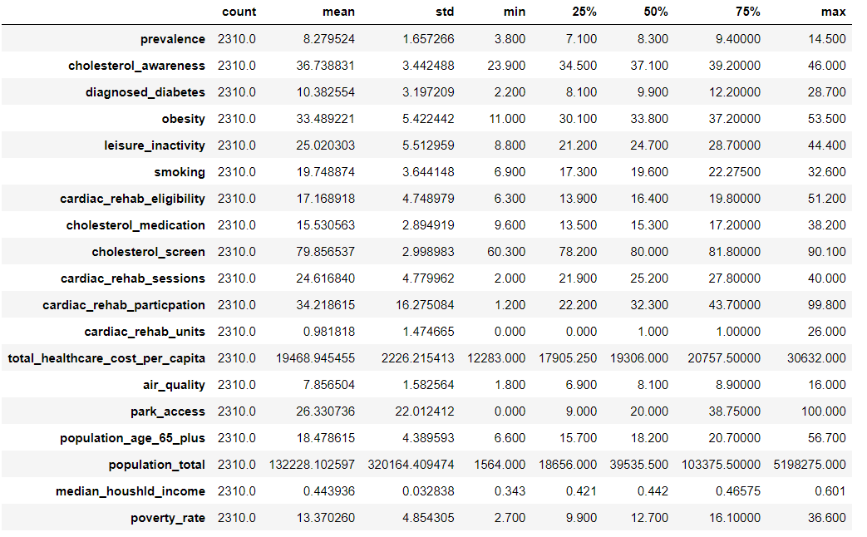
Summary Statistics of Selected Variables

Slide 7
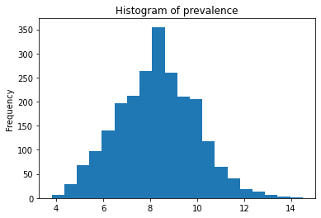
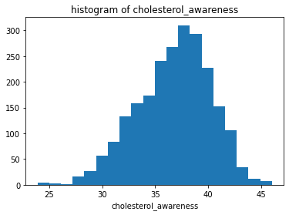
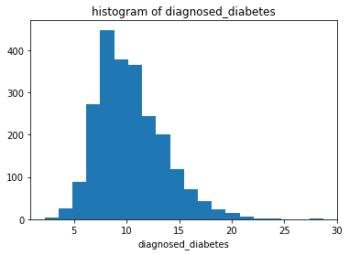
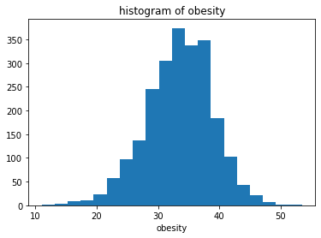
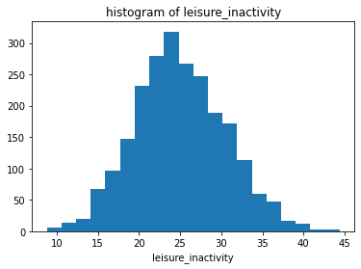
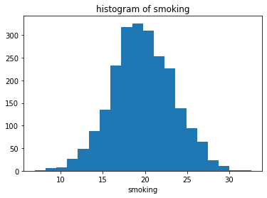
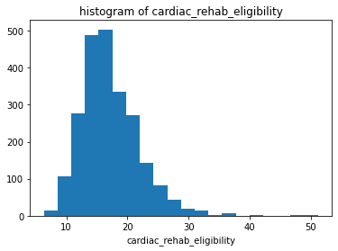
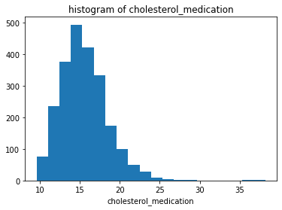
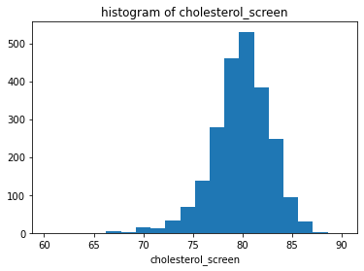
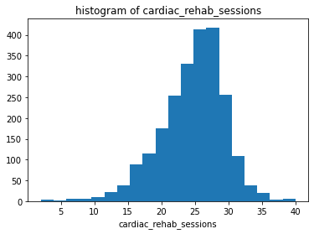
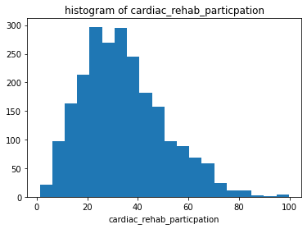
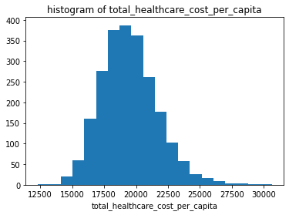
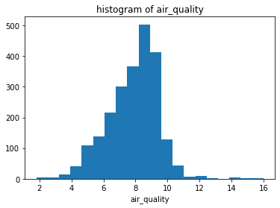
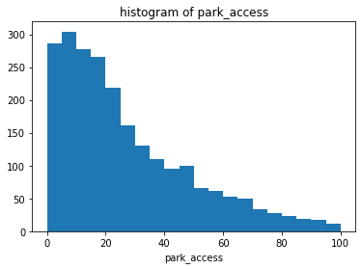
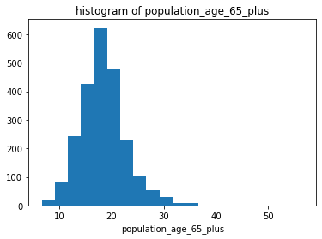
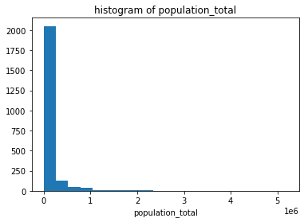
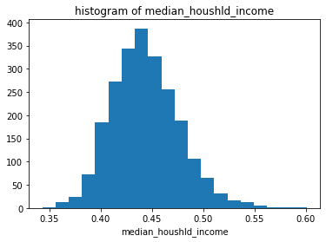
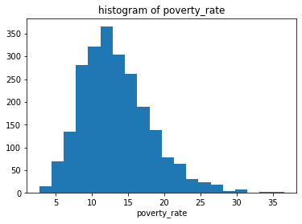
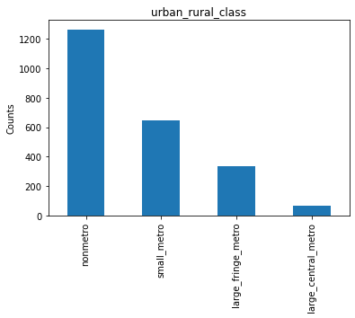
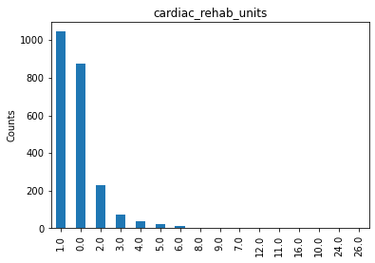
Univariate Distribution (Histograms) of Selected Variables

Slide 8
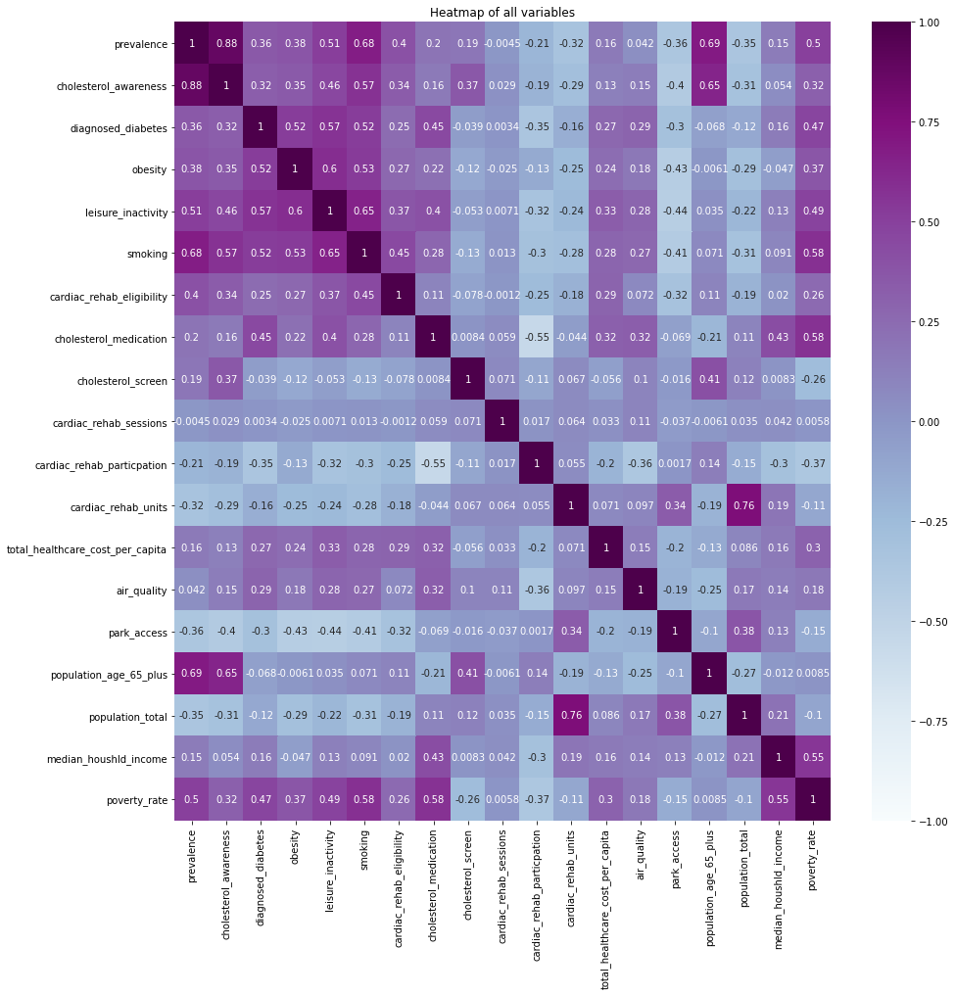
Heat Map of Selected Variables

Slide 9
Modeling
Multiple linear regression models with feature reduction / selection
Dimensionality Reduction with Principal Components Analysis.
Attempts to simplify the regression model by using fewer predictors.
Not satisfactory! 12 principal components required to capture 90% of the variance.
Predictor selection by Exploratory Regression method.
Four predictors were removed due to high p-values.
Predictor selection with Lasso regularization approach
Penalized 12 insignificant predictors.
Predictor selection with LassoCV approach.
Penalized 3 insignificant predictors.
Penalized variables can be said to be insignificant because their effects are accounted for by another correlated variable(s) that is/are likely to be more correlated with prevalence.

Slide 10
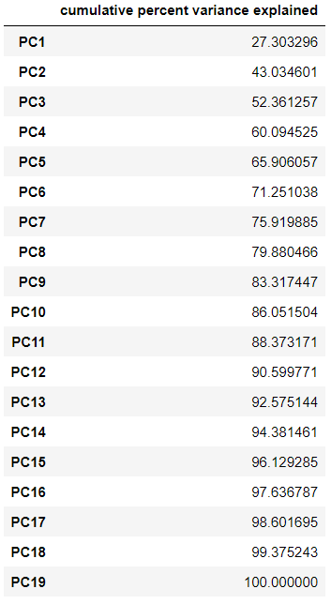
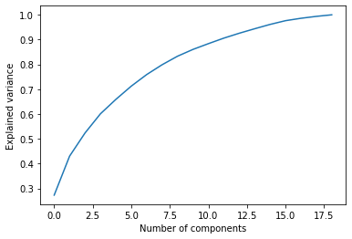
Modeling (Cont’d)
Result of Principal Component Analysis

Slide 11
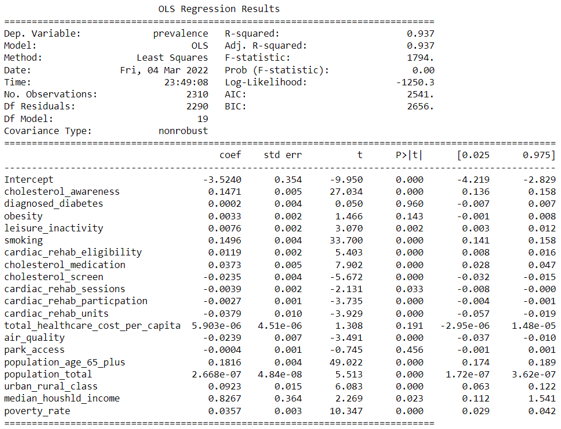
Modeling (Cont’d)
Result of Exploratory Regression
Diabetes, obesity, total health care cost per capita and park access are penalized in all three models due to high p-values (> 0.05)

Slide 12
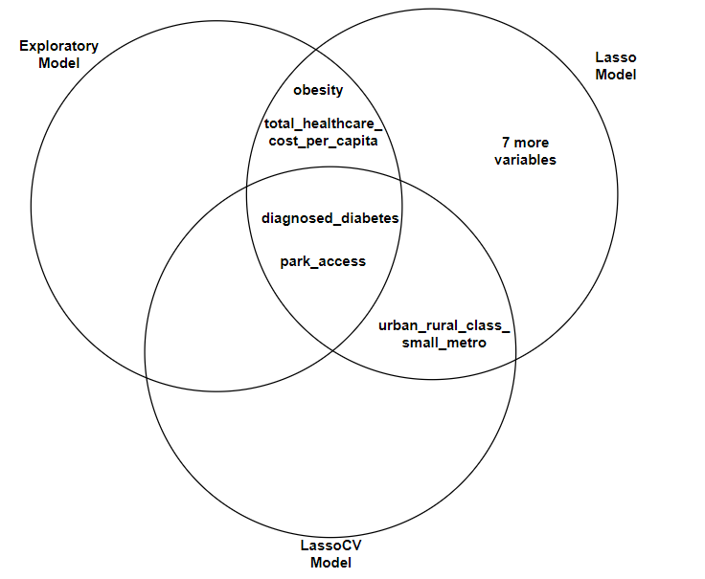
Modeling (Cont’d)
Penalized (Insignificant) Predictors
Exploratory model
diagnosed_diabetes
obesity
park_access
total_healthcare_cost_per_capita
Lasso model
diagnosed_diabetes
obesity
cholesterol_screen
cardiac_rehab_sessions
cardiac_rehab_units
total_healthcare_cost_per_capita
air_quality
park_access
population_total
median_houshld_income
urban_rural_class_large_fringe_metro
urban_rural_class_small_metro
LassoCV model
diagnosed_diabetes
park_access
urban_rural_class_small_metro

Slide 13
Modeling (Cont’d)
Preprocessing:
Target variable (prevalence)
One-hot encoding (urban-rural class)
Standard normalization (all predictors)
Train-test set split - 75:25
Model Evaluation Results
Model | R² Value | Test Error (% Prevalence)
MLR_PCA | 88.89 | 0.501
MLR_SIMPLE | 91.73 | 0.439
MLR_LASSO | 91.99 | 0.432
MLR_LASSOCV | 91.93 | 0.434

Slide 14
Model Results
Best model is the MLR-Lasso because it is the simplest with least number of predictors, as the most accurate (i.e., having most R² value and least test error.
Using this model, we can predict prevalence by an error of 0.432%.
Using the model, 91.99% variance in prevalence can be explained by the variance in the influencing factors.

Slide 15
Conclusion
We have explored the causal relationship between heart disease prevalence and the risk factors, health care opportunities and socio-economic factors. It is possible to predict prevalence of heart disease from these factors.
Given the dataset, the best factors that seem to influence prediction of prevalence of heart diseases are:
High cholesterol awareness, leisure time physical inactivity, smoking, cardiac rehabilitation eligibility, cardiac rehabilitation participation, cholesterol medication, population of aged 65 and above, poverty rate, urban-rural classification.
Note that these factors were arrived at given the dataset used. Using another dataset from a different source may yield different outcomes.
Assumptions made during the analyses may not necessarily be accurate (e.g. coronary heart disease may not be impacted the same way as other type of heart diseases).

Slide 16
Thank you!!!

